Slide 1
Introduction to Content Rendering
Objectives:
Explain JCR nodes, properties, and namespaces
Describe the structure of a component
Describe dialogs
Explain the Sling resolution process

Slide 2
JCR Nodes and Properties
JCR is a tree structure that contains items.
Nodes provide structure
Properties store data
Item names should be meaningful.
Item addresses are stored in the form of paths.
/blog/jan/31/title
blog/jan/1
/(root)
/blog
/jan
/feb
/1
.....
/31
title=My First Post!
body=<h1>Helloworld</h1>
Keywords=[foo, bar]
Notes:
The JCR repository serves AEM as a database, but it is not structured like traditional relational databases. Instead of tables with rows and columns it is a tree with nodes and properties.
Nodes and properties are collectively known as items.
Nodes give the tree its structure while properties store the data.
Nodes can have parents and children. Properties are always the children of a node and do not have children.
Items are stored according to their names and addressed via paths. Paths may be absolute (/blog/jan/31/title) or relative (blog/feb/5)
Item names should be meaningful creating paths that describe the data. The path “/blog/jan/31/title” describes the data to expect.
Properties can be single or multi-valued. If a property name is plural and followed by square brackets like keywords[] you can expect it to be multi-valued. Multi-valued properties behave like arrays.

Slide 3
JCR Nodes and Properties (Cont.)
parent node
this node
node type:
nt:folder nt:file nt:unstructured rep:User rep:ACL nt:nodeType …
mixin types:
mix:versionable mix:lockable sling:VanityPath cq:Taggable ...
single value properties: value
string long date path binary ...
multi-value properties: values[]
string long date path binary ...
child nodes
Notes:
Looking more closely at a node there are a number of other features worth noting:
Nodes have a type. The node type sets rules about what kinds of properties and child nodes a node can or must have. For example; a node of type cq:page must always have a child node named jcr:content of type cq:PageContent.
Nodes can also have zero to many mixin types. A mix-in type is an add-on; it specifies additional properties and child nodes the node must or may have. Common mixin types include mix:versionable and mix:referenceable.
Looking at the properties, a node may have any number of properties for storing information. Nodes can be single or multi-valued. A multi-valued property is notated and behaves much like an array. Multi-valued properties usually have plural names. So, here we see a single value property named value and a multi-valued property named values[ ].

Slide 4
Namespaces
Nodes and properties can have namespaces to avoid name collisions.
Common namespaces are:
jcr: Basic data storage (part of jcr spec)
nt: Foundation node types (part of jcr spec)
rep: Repository internals (part of jcr spec)
mix: Standard mixin node types (part of jcr spec)
sling: Added by Sling framework
cq: Added by the Adobe Experience Manager (AEM) application
Notes:
All node types and many properties have names that start with a namespace prefix. These can often serve as a clue as to what part of the system’s functionality the item is associated with.
cq shows up as the AEM product itself used to be known as Communique prior to version 6.0.

Slide 5
Common Node Types
NT
AEM
Node Type | Description
nt:file | Represents a file in a filesystem
nt:folder | Represents a folder in a filesystem
nt:unstructured | Enables any combination of child nodes and properties. It also supports client-orderable child nodes and stores unstructured content and commonly used (for the touch UI) dialog boxes.
Node Type | Description
cq:Page | Stores the content and properties for a page in a website.
cq:Template | Defines a template used to create pages.
cq:ClientLibraryFolder | Defines a library of client-side JavaScript CSS.
cq:EditConfig | Defines the editing configuration for a component including drag-and-drop and in-place editing.
cq:InplaceEditingConfig | Defines an in-place editing configuration for a component. It is a child of cq:EditConfig.
Notes:
Note to CDs
Exception: The text font size inside the table can vary from 18, 20, to 22 points, depending upon how much content your table has.

Slide 6
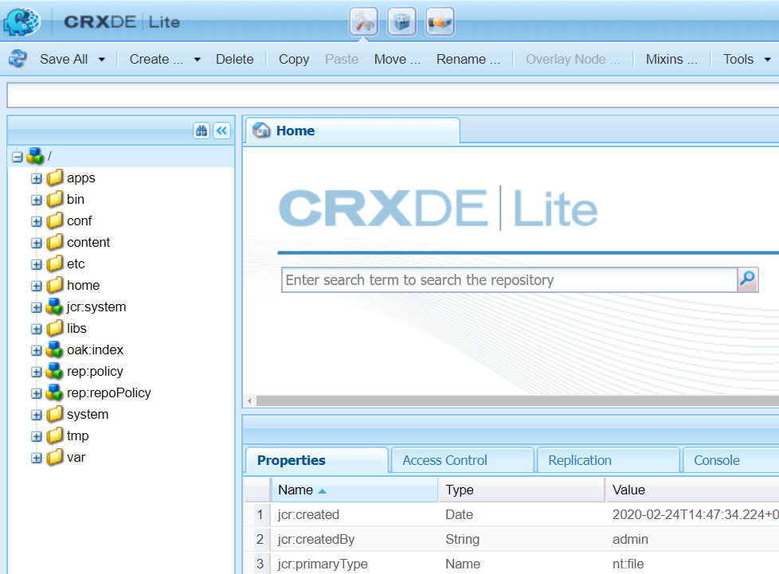
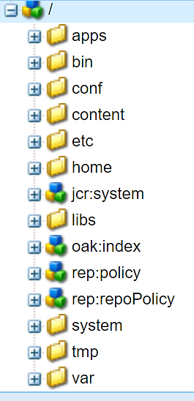
Folder Structure of the Repository
1
1
/apps – clientlibs, components, bundles, front-end developers’ work
2
/conf – context-aware and global configurations such as editable templates, metadata schemas, metadata profiles, search filters, and cloud configurations
2
3
4
3
/content – page content authored by authors
4
/libs – foundation components, css, and library files
Notes:
Here’s what each of the folders contain:
/apps—all custom templates, components, and any other definitions related to your site are stored here. When you inherit foundation components, it is done from the libs folder. Always copy the components from the libs folder to the apps folder, and then modify it in the apps folder. By doing this, no code will be lost when you upgrade Adobe Experience Manager. You just need to update the apps folder. /conf—contains all configurations for your site. Since Adobe Experience Manager 6.2, this folder is used to store the dynamic templates and policies for your site.
/content—all content of your website is stored in this folder.
/etc—contains all resources related to utilities and tools.
/libs—all libraries and definitions that belong to Adobe Experience Manager code are stored here. It includes out-of-the-box components, templates, and other Adobe Experience Manager features such as search or replication. It is also referred to as the foundation components. Avoid making any modifications to any of the components in libs.
/home—contains all information related to users and groups.
/tmp—a temporary working area.
/var—contains files that change and are updated by the system, such as audit logs, statistics, and event handling.
/oak:index—contains Jackrabbit Oak index definitions. Each node specifies the details of one index. Standard indexes for the AEM application are visible and additional custom indexes can be created.
In this presentation, we will be concerned about 1) apps, and 2) content nodes.

Slide 7
Folder Structure of the Repository (Cont.)
5
/home – Contains AEM users and group information
5
/oak:index – Jackrabbit Oak index definitions
6
6
7
/system – Used by Apache Oak
7
8
/var – audit logs, statistics, event-handling
8
Notes:
/home—contains all information related to users and groups.
/libs—all libraries and definitions that belong to Adobe Experience Manager code are stored here. It includes out-of-the-box components, templates, and other Adobe Experience Manager features such as search or replication. It is also referred to as the foundation components. Avoid making any modifications to any of the components in libs.
/oak:index—contains Jackrabbit Oak index definitions. Each node specifies the details of one index. Standard indexes for the AEM application are visible and additional custom indexes can be created.
/system - Is used by Apache Oak only.
/var—contains files that change and are updated by the system, such as audit logs, statistics, and event handling.
In this presentation, we will be concerned about 1) apps, and 2) content nodes.

Slide 8

Which node type supports client-orderable child nodes and is commonly used for touch UI dialog boxes?
nt:folder
cq:InplaceEditingConfig
nt:unstructured
cq:ClientLibraryFolder
Notes:
Correct Answer: C

Slide 9
Separation of Content and Code
AEM maintains separation of concerns.
Content: Anything that is authored by an end user.
Unique
Created in the AEM UI
Points to code (component) to render it
Code: Anything that is developed.
Highly modular and reusable
Created in a development cycle
Can point to other components to reuse code
A node of type cq:Component

Slide 10
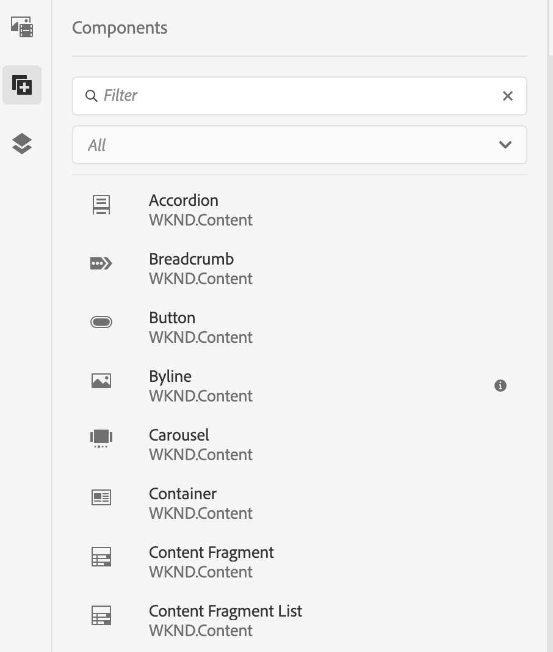
Components: AEM Building Blocks
Modular units for authors to build pages
Exist as nodes and properties
Contains a collection of scripts that implement a specific functionality
Have no hidden configuration files
Use dialogs that enable authoring input
Use HTML Template Language (HTL)
Adobe’s Core Components can be extended for customizations
Notes:
In AEM, a component is a resource type. It contains a collection of scripts that implement a specific functionality to present the content on your website.

Slide 11
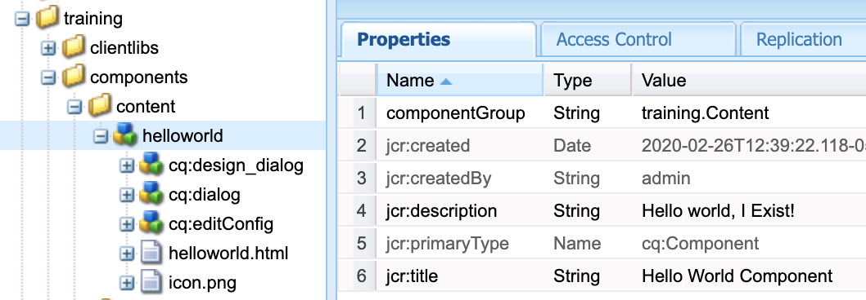
Structure of a Component
Common elements of components:
Root node with properties:
jcr:title
jcr:description
componentGroup
Optional child nodes:
cq:editConfig (authorable actions)
cq:dialog (dialog)
cq:design_dialog (content policy dialog)
cq:template (initial content)
icon.png (icon in page editor)
More on components later…
Notes:
Root node: Is the hierarchy node of the component and represented as node <mycomponent> (type cq:Component).
Vital Properties
The vital properties of a component are:
• jcr:title: Component title; for example, used as a label when the component is listed in the components browser
• jcr:description: Description for the component; can be used as mouse-over hint in the components browser
• cq:icon: String property pointing to a standard icon in the Coral UI library to display in the component browser
Vital Child Nodes
The vital child nodes of a component are:
• cq:editConfig (cq:EditConfig): Defines the edit properties of the component and enables the component to appear in the Components browser
• cq:childEditConfig (cq:EditConfig): Controls author UI aspects for child components that do not define their own cq:editConfig
• cq:dialog (nt:unstructured): Dialog for this component. Defines the interface allowing the user to configure the component and/or edit content.
• cq:design_dialog (nt:unstructured): Design editing for this component

Slide 12
Exercise 1: Create an HTL Component

Slide 13
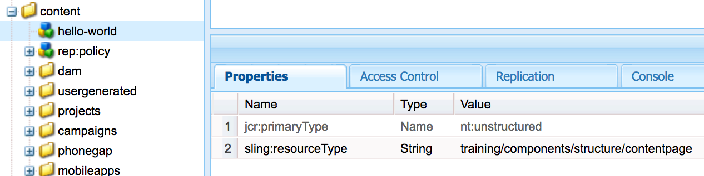
Content Nodes
Exist under /content
Typically created/managed by AEM Authors
Use sling:resourceType property to call a component
Can be complex data structures:
Webpages
Assets
Content Fragments
Experience Fragment

Slide 14
Exercise 2: Create content to render the component

Slide 15
Sling Resolution Process
Sling is resource-oriented.
All resources are maintained in the form of a virtual tree.
A resource is usually mapped to a JCR node, but can also be mapped to a file system or database.
Common properties that a resource can have:
Path
Name
Resource Type
URL ➔ Resource = JCR Structure

Slide 16
Processing Requests
Each content item in JCR is exposed as an HTTP resource.
After the content is determined, the script or the servlet to be used to handle the request is determined through the following:
Properties of the content item
HTTP method used to make the request
Simple naming convention within the URL that provides secondary information

Slide 17
Processing Requests: Steps
Decompose the URL.
Search for a servlet or a vanity URL redirect.
Search for a node indicated by the URL.
Resolve the resource.
Resolve the rendering script/servlet.
Create a rendering chain.
Invoke a rendering chain.

Slide 18
Decomposing the URL: Example
URL: http://myhost/tools/spy.printable.a4.html/a/b?x=12
where:
Protocol: Is the Hypertext Transfer Protocol (HTTP)
Host: Is the name of the website
Content path: Is the path specifying the content to be rendered
Selector(s): Is used for alternative methods of rendering the content
Extension: Is the content format that also specifies the script to be used for rendering
Suffix: Can be used to specify additional information
Param(s): Are any parameters required for dynamic content
Protocol | Host | Content path | Selectors | Extension |  | Suffix |  | Params
http:// | myhost | tools/spy | Printable.a4 | html | / | a/b | ? | X=12

Slide 19
Resolving Requests to Resources: Example 1
URL: http://myhost/tools/spy.html
Steps to map the request are:
The Sling Resource Resolver process first looks for a redirection rule. If this does not exist or is not found, then the script resolution process begins.
As part of the script resolution process, Sling searches for the node.
If a node is found, then the Sling resource type for that node is extracted and used to locate the script to be used for rendering the content.
If no node is found, then Sling will return the http code 404 (Not Found).
1
2
3
4
Notes:
Once the URL is decomposed, the content node is located from the content path. This node is identified as the resource, and performs the following steps to map to the request described here on this slide.

Slide 20
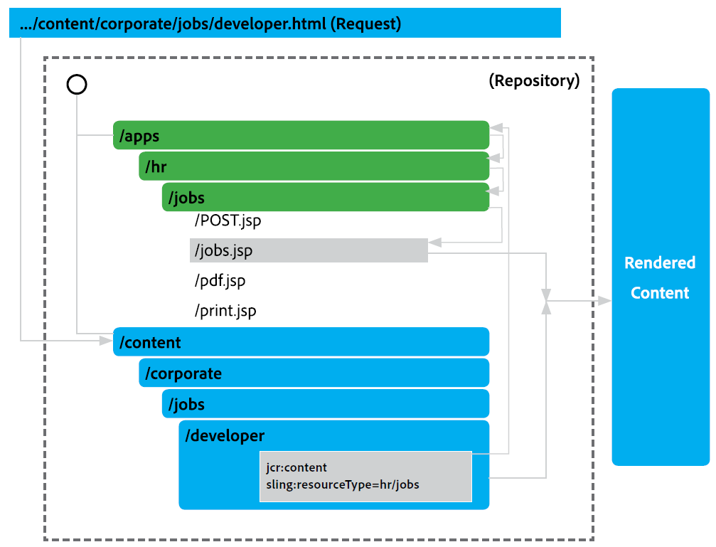
Resolving Requests to Resources: Example 2
URL: http://myhost/content/corporate/jobs/developer.html
Notes:
Consider the URL request: http://myhost/content/corporate/jobs/developer.html and corresponding diagram. Note the properties of the developer node are used to provide the rendered content.

Slide 21
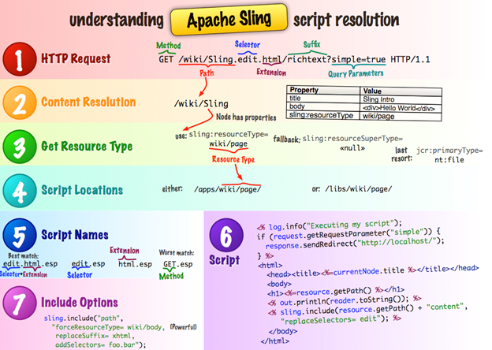
URL Decomposition
Notes:
Each content item in the JCR repository is exposed as an HTTP resource, so the request URL addresses the data to be processed, not the procedure that does the processing. After the content is determined, the script or servlet to be used to handle the request is determined in cascading resolution that checks, in order of priority:
Properties of the content item itself
The HTTP method used to make the request
A simple naming convention within the URL that provides secondary information
Therefore, it must be noted again that chronologically, the Sling Resource Resolver first tries to resolve the URL to a servlet or redirect. If this does not exist or is not successful, then the script resolution process described here in this diagram (also known as the cheatsheet) takes place.
Resource resolution is focused on nodes, not serving up files. Sling is about resources, and AEM is not a file server. So note here that finding “files” with “extensions” is really a last resort (see #3 in the slide – the sling:resourceType is what is almost always used).

Slide 22
Exercise 3: Search for a rendering script

Slide 23
Enable Components for Authors
Components can be dynamically added to pages by authors
Minimal Component requirements:
A defined componentGroup property
A defined jcr:title property
A script with HTML
A dialog node

Slide 24
Exercise 4: Use the authoring interface to add content

Slide 25
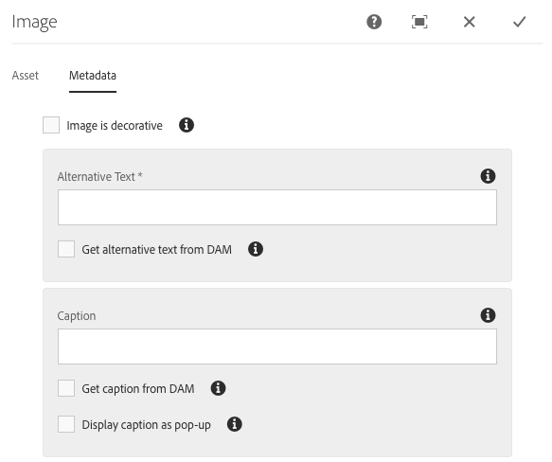
Authoring Dialogs
Form based
Add content to a component
Many Formfields
Single Line Text
Boolean
Radio Button
Drop Down
File Upload
And more..
Show/Hide formfield rules
Optional Validation

Slide 26
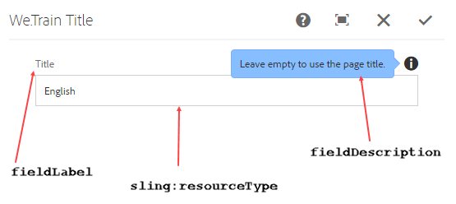
Component Dialog Box
A dialog box gathers user input using a form, potentially validates it, and then makes that input available for further use.
Notes:
Dialog boxes are small temporary windows that are used to enable the user to provide additional inputs. These inputs are either used to perform some action, or are stored in the repository.

Slide 27
Copy and Customize Dialogs
cq:dialog node structures can quickly become complex.
Easy customizable approach:
Look through core component dialogs and find the dialog features needed.
In the JCR, copy dialogs from the pre-existing core components.
Paste dialogs in the new component.
Customize to your needs.
Ensure the formfields persist to the correct properties.
name=./yourCustomProperty
Reference the formfield values in your HTL script.
More on dialogs later…
Notes:
Dialog boxes are small temporary windows that are used to enable the user to provide additional inputs. These inputs are either used to perform some action, or are stored in the repository.

Slide 28
Exercise 5: Create an edit dialog

Slide 29
Render different code with Sling
Sling selectors can be used to influence which component scripts to render
Example:
http://localhost:4502/path/to/my/page.print.html
sling:resourceType=wetrain/components/quote
+ quote (component)
quote.html
blue.html
pdf.html
print.html

Slide 30
Exercise 6: Customize selectors

Slide 31
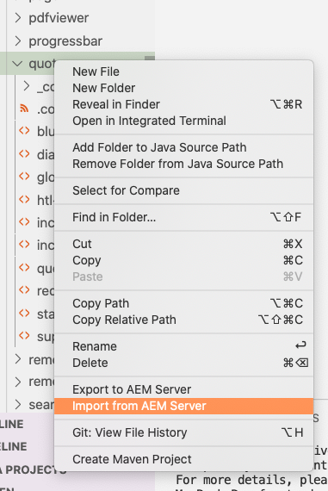
Sync back to your project
Development work in CRXDE Lite needs to sync back to the local project
Make sure you have an IDE with a sync tool
In the IDE, select the parent folder
Select Import from AEM Server
Use CRXDE Lite sparingly
Copy from core components
Overlays from libs
Verify code deployed into the JCR
Local Quickstart

Slide 32
Exercise 6: Import Quote to the Project

Slide 33
The JCR has a hierarchical tree structure with two items, nodes and properties.
All nodes and properties of JCR are stored in different namespaces.
AEM uses different folder structures to store and organize the content in the JCR.
AEM stores content and script in JCR through cq:Page and cq:Component nodes respectively.
In AEM, a request URL is first resolved to a resource, and then based on the resource, Sling selects the servlet or the script to handle the request.

Slide 34
Identify the best matching script name to render the resource for the following request: GET content/site/company.min.html
company.html
Min.html
Html.html
Default.html
Notes:
Answer(s): B

Slide 35
Which of the following represents the selector in the request: GET /content/we-train/en.teaser.html/a/b.txt?q=tex
teaser
en
a/b
a./b.txt
Notes:
Answer(s): A

